Slide 1
Acova Radiateurs
Team members:
Ayush Krishna - 19HS20012
Priyam Saha - 19HS20030
Priyansha Gupta - 19HS20031
Srimahn - 19HS20050

Slide 2
Overview of Acova
Started in 1933 with manufacturing of burners and boilers
In 1960, focus shifted to decorative steel radiators
Acova’s core strength was their custom made products
Acova mastered a complicated production process, but management believed it can be optimised
Spent more than industry standards on marketing and advertising
Created a brand image, making “Acova” the generic name of their products

Slide 3
Overview of Baring Capital Investors
Started in 1986 to organise and invest in management buy-outs and late stage development capital situations in Europe
Part of Barings plc, a merchant bank, but operated independently
Typically invested in industrial companies with consistent cash flows and sound and responsive management
Worked closely with existing management to make operational and administrative improvements
Preferred companies whose internal cash flow can repay the buyout debt, rather than going for asset sales

Slide 4
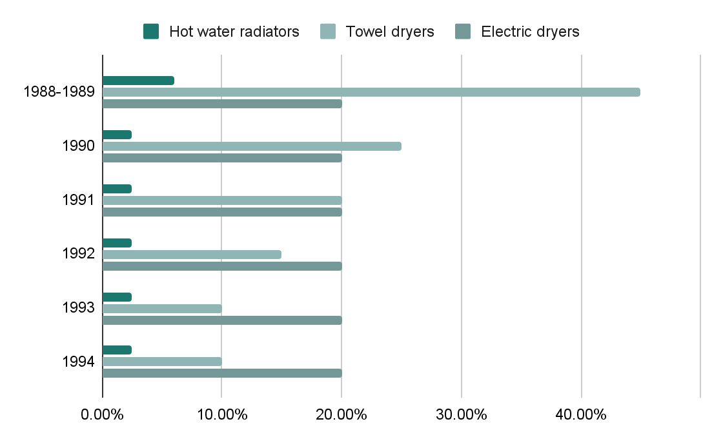
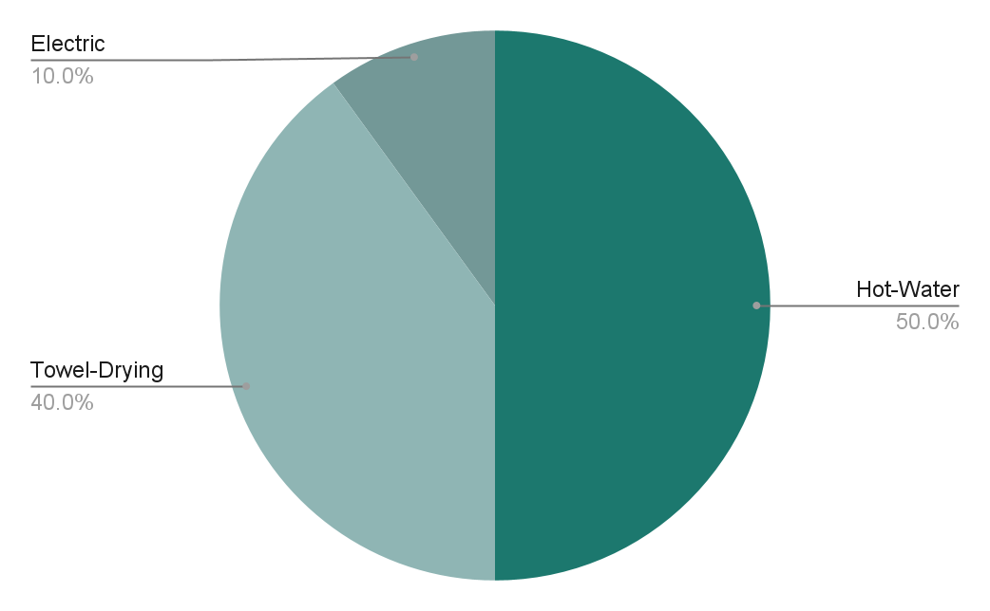
Market of Radiators
Market Segment of Acova by product
Forecasted growth rate of different segments

Slide 5
Pro and Cons of Acova’s LBO
Strong cash flow generation ability
Leading and defensible market position
Growth opportunities in towel drying radiator and electric radiator business line
Cross border expansion and efficiency improvement
Sound and reliable management
Pros
Adverse impact on employees due to restructuring
Baring usually take hold of positions in Board of Directors, which may lead to conflict, leading to hostile takeover
Potential optimization of Production process not quantified
Cons

Slide 6
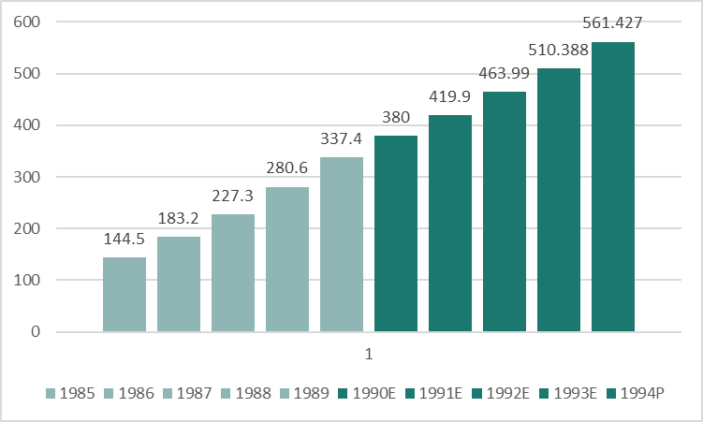
Management’s forecasts
Sales (Actual and Forecasts)
Forecasts need not be discounted as growth assumptions seems to be reasonable

Slide 7
Cost of debt
Tranche | Amount | Fully Drawn Cost | Weighted average
Senior debt | 190000.0 | 12.00% | 7.95%
Subordinate debt | 65000.0 | 13.50% | 3.06%
WC loan | 31800.0 | 11.000% | 1.22%
Total | 286800.0 |  | 12.23%

Slide 8
Cost of Equity
Risk-free Rate (Rf) | 10.06%
EQ Risk Premium(Rp) | 2.4%
Target terminal D/E | 0.5
Asset beta | 1.5
Equity beta | 1.9725
Cost of equity | 14.79%
Assumptions:
Target terminal D/E is taken as 0.5 considering data for US home appliance firms
Asset beta is taken to be 1.5, using industry's beta from Aswath Damodaran

Slide 9
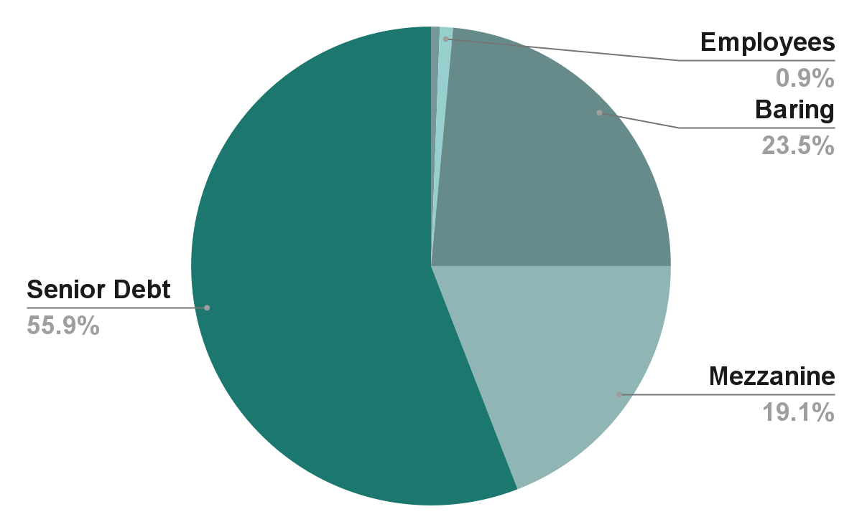
Terminal WACC
Deal Structure
Target D/EV | 33.33%
Target E/EV | 66.66%
Cost of equity | 14.79%
Cost of debt | 12.23%
After tax WACC | 12.43%

Slide 10
Cash Flows
 | 1989 | 1990 | 1991 | 1992 | 1993 | 1994
EBIT | 34,907 | 43,120 | 55,989 | 70,897 | 77,205 | 85,077
Pretax profit | 31,187 | 22,101 | 19,165 | 34,737 | 46,656 | 57,284
Net income | 19,648 | 13,924 | 12,074 | 21,884 | 29,393 | 36,089
Depreciation | 11,700 | 19,000 | 20,000 | 25,000 | 25,000 | 25,000
Amortization of acquisition costs | 0 | 3333 | 3333 | 3333 | 0 | 0
Capital expenditures | 29,000 | 20,000 | 25,000 | 25,000 | 25,000 | 25,000
Change in net working capital |  | -7898 | -7461 | -8245 | -8676 | -9544
Cash flow available | -- | 8,359 | 2,946 | 16,972 | 20,717 | 26,545
Principal payments |  | 8,359 | 2,946 | 16,972 | 20,717 | 26,545
Equity cash flow |  | 0 | 0 | 0 | 0 | 0
Notes:
Abc

Slide 11
Terminal value
Sales (1995) | 575462.68
EBIT (1995) | 87203.93
EBIAT=EBIT*(1-t) | 54938.47
Depreciation | 25000.00
Capex | 25000.00
Change in WC | 2624.52
FCF assets | 52313.95
Terminal value assets | 526786.29
Terminal value of debt | 211260.91
Terminal value of equity | 315525.38

Slide 12
Sensitivity analysis- Equity Value
 |  | WACC
 |  | 11.98% | 12.13% | 12.28% | 12.43% | 12.58% | 12.73% | 12.88%
Growth rate | 2.20% | 323604.3 | 315525.4 | 307686.9 | 300078.3 | 292689.5 | 285511.3 | 278534.6
 | 2.30% | 329129.3 | 320883.9 | 312886.4 | 305125.7 | 297591.4 | 290273.8 | 283163.7
 | 2.40% | 334769.7 | 326352.6 | 318191.1 | 310273.7 | 302589.6 | 295128.6 | 287881.2
 | 2.50% | 340529.0 | 331934.8 | 323604.3 | 315525.4 | 307686.9 | 300078.3 | 292689.5
 | 2.60% | 346411.2 | 337634.2 | 329129.3 | 320883.9 | 312886.4 | 305125.7 | 297591.4
 | 2.70% | 352420.1 | 343454.5 | 334769.7 | 326352.6 | 318191.1 | 310273.7 | 302589.6
 | 2.80% | 358559.8 | 349399.5 | 340529.0 | 331934.8 | 323604.3 | 315525.4 | 307686.9

Slide 13
IRR
 |  | WACC
 |  | 11.98% | 12.13% | 12.28% | 12.43% | 12.58% | 12.73% | 12.88%
Growth rate | 2.20% | 30.65% | 29.99% | 29.34% | 28.70% | 28.06% | 27.42% | 26.79%
 | 2.30% | 31.10% | 30.43% | 29.78% | 29.13% | 28.48% | 27.84% | 27.21%
 | 2.40% | 31.54% | 30.87% | 30.21% | 29.56% | 28.91% | 28.27% | 27.63%
 | 2.50% | 31.99% | 31.32% | 30.65% | 29.99% | 29.34% | 28.70% | 28.06%
 | 2.60% | 32.44% | 31.77% | 31.10% | 30.43% | 29.78% | 29.13% | 28.48%
 | 2.70% | 32.90% | 32.22% | 31.54% | 30.87% | 30.21% | 29.56% | 28.91%
 | 2.80% | 33.36% | 32.67% | 31.99% | 31.32% | 30.65% | 29.99% | 29.34%
Proceeding with the proposed bid of 85M, we will get an IRR of 29.99%

Slide 14
Bid recommendation
Proceed with the proposed bid of 85M
Estimated IRR of ~30% just satisfies the hurdle rate

